Slide 1
Flight booking system
Jaspreet singh & Roheel Ahmed
BIRMINGHAM CITY UNIVERSITY
CMP5332-A-S1
2020/2021

Slide 2
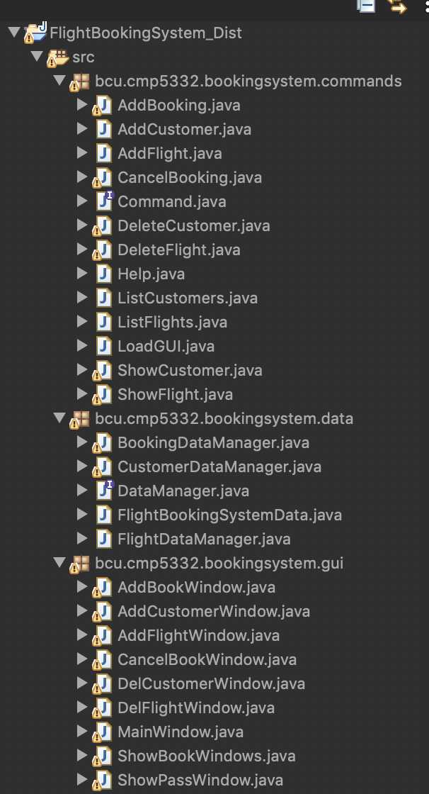
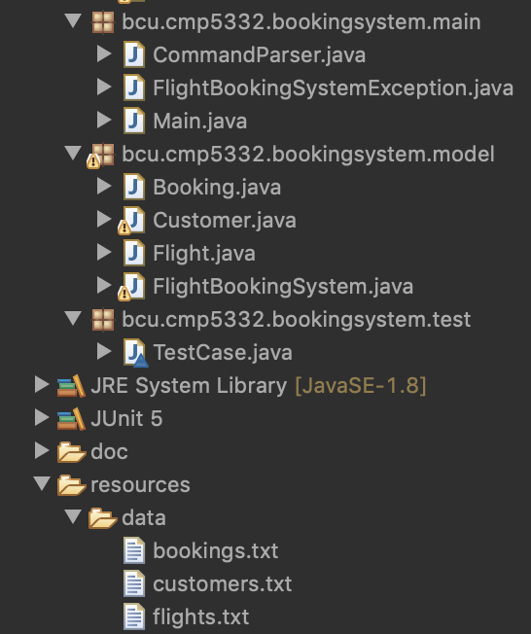
FOLDER STRUCTURE AND FILES
Packgages organized in base of their own type or functionality in the program itself.
Creation of various classes to implement functionalities.
Slightly changes to the classes given at start.
Creation of new ”Test” package.
Creation of Java-Doc

Slide 3
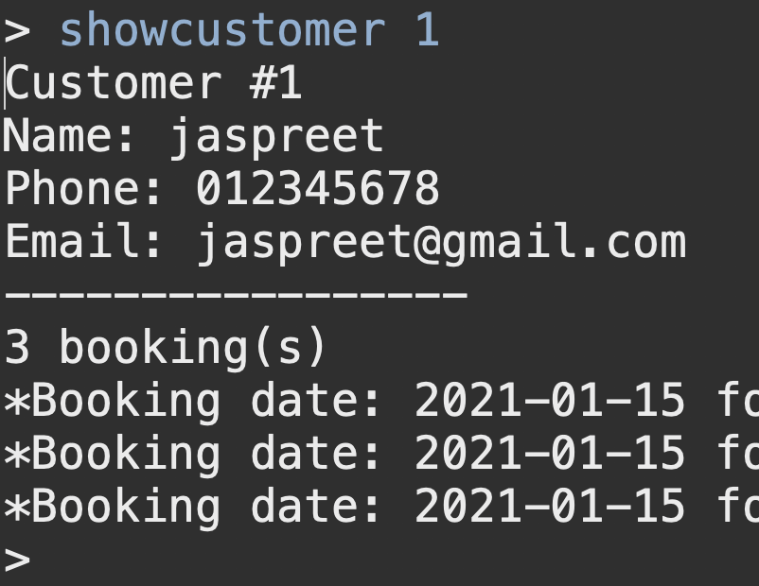
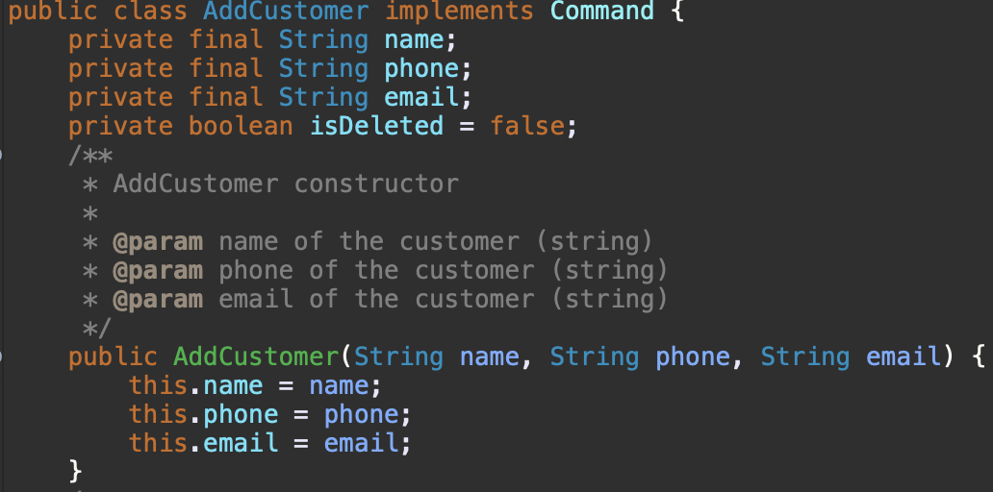
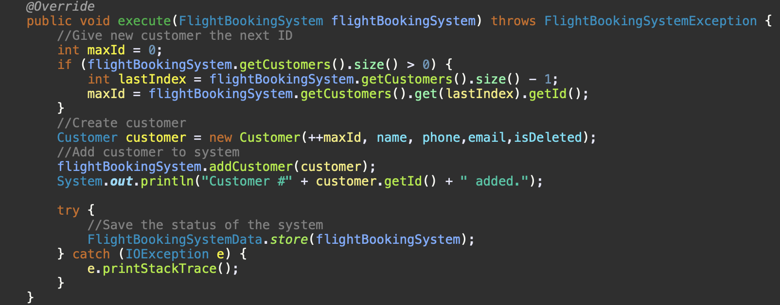
ADD customers code
Here it’s the code to add a customer to the system with all it’s various information and with the print show option we can see all the information we put in about the customer itself as ID, name, phone No, mail and number of bookings as well as which these are and when they were done

Slide 4
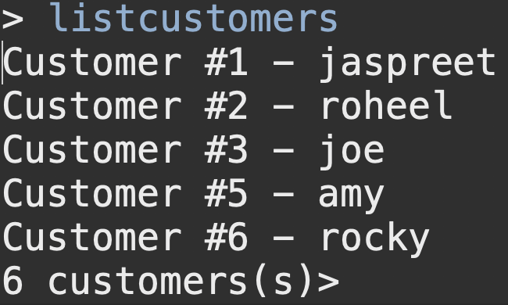
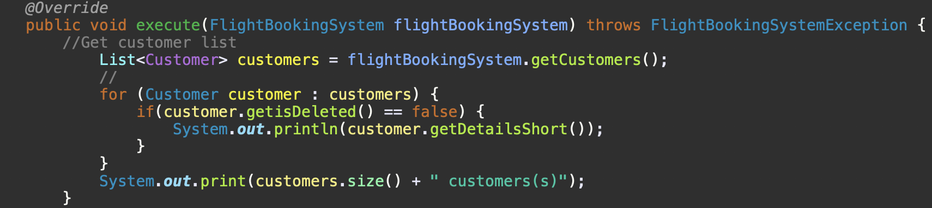
list customer code
Here it prints all the customers of the system with their # as CustomerID and name other than print all the customers present in the system, even those who have been deleted/hided

Slide 5
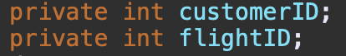
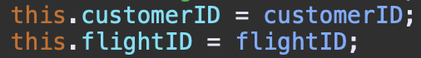
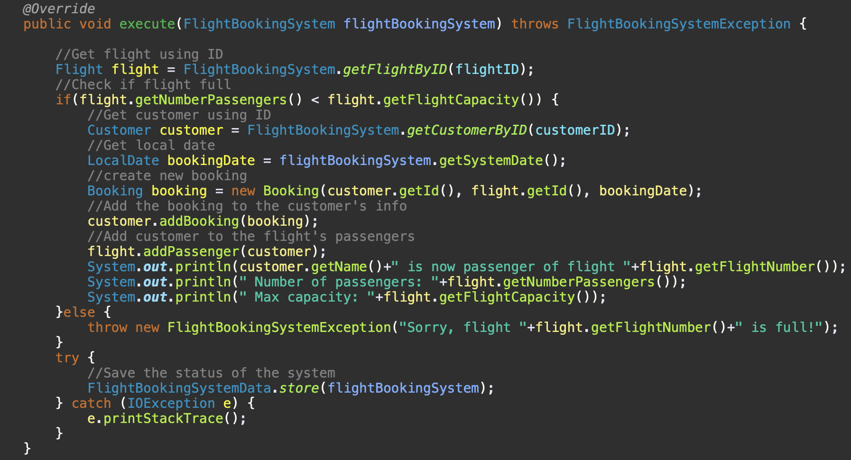
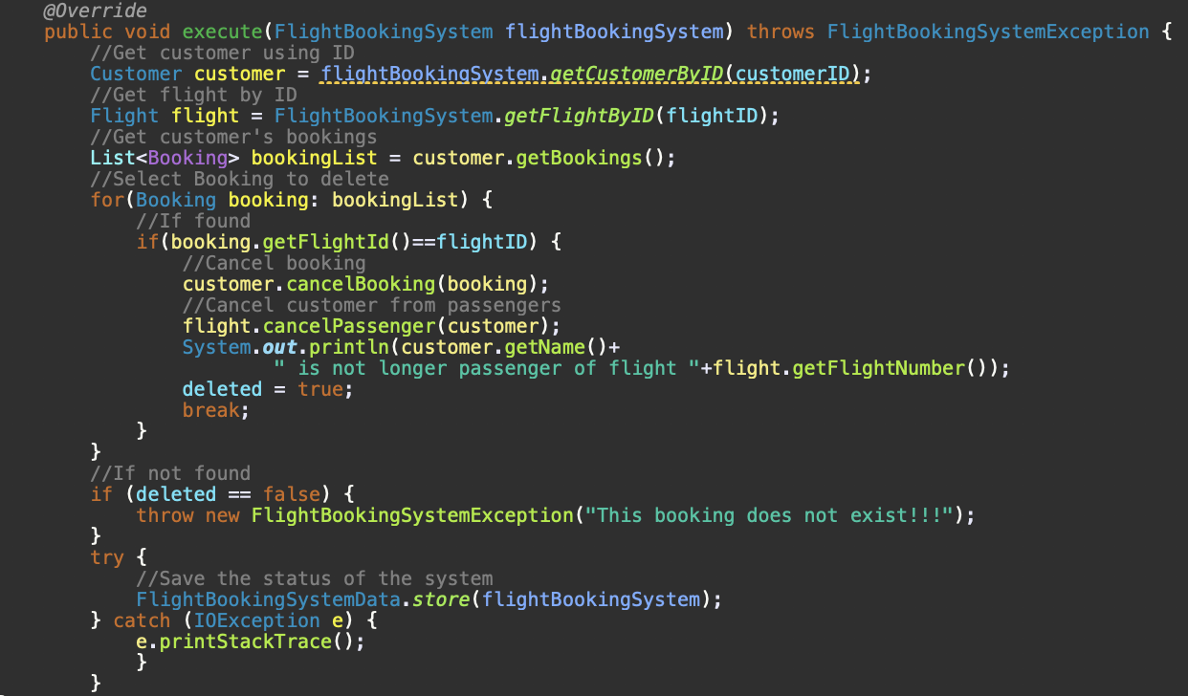
Issue and cancel bookings
Both methods use the same data to complete the command while the add uses them to create the booking while adding a localdate data too the delete use them to locate the exact booking to delete

Slide 6
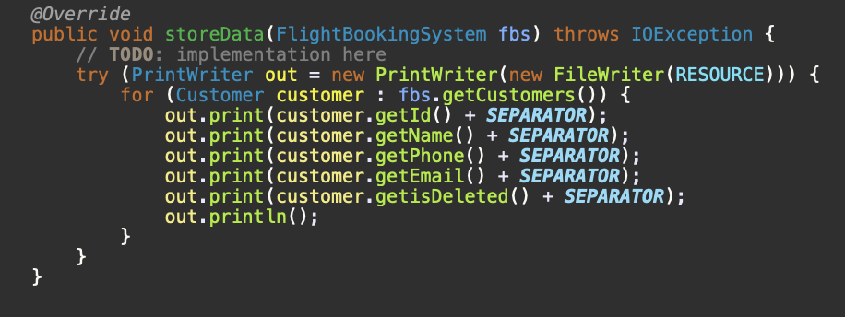
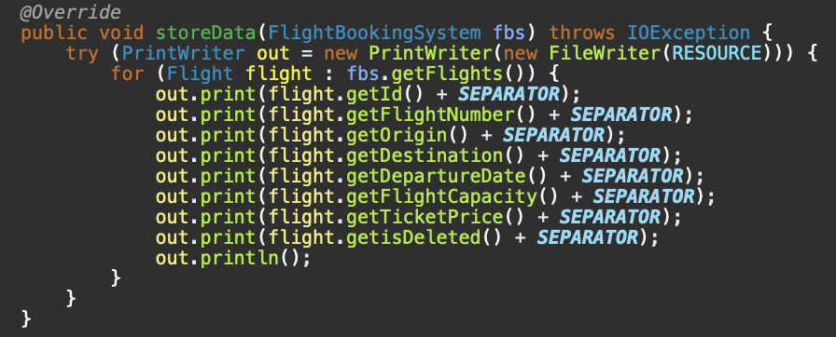
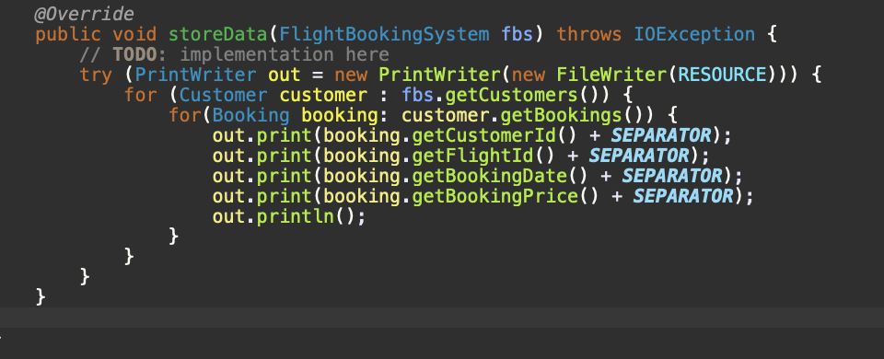
Save data
These store data scripts save the various data about the customers, the flights and the bookings and save them into their own txt file

Slide 7
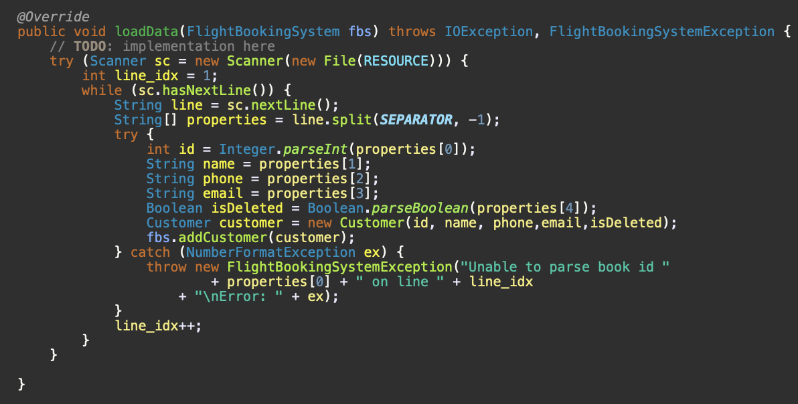
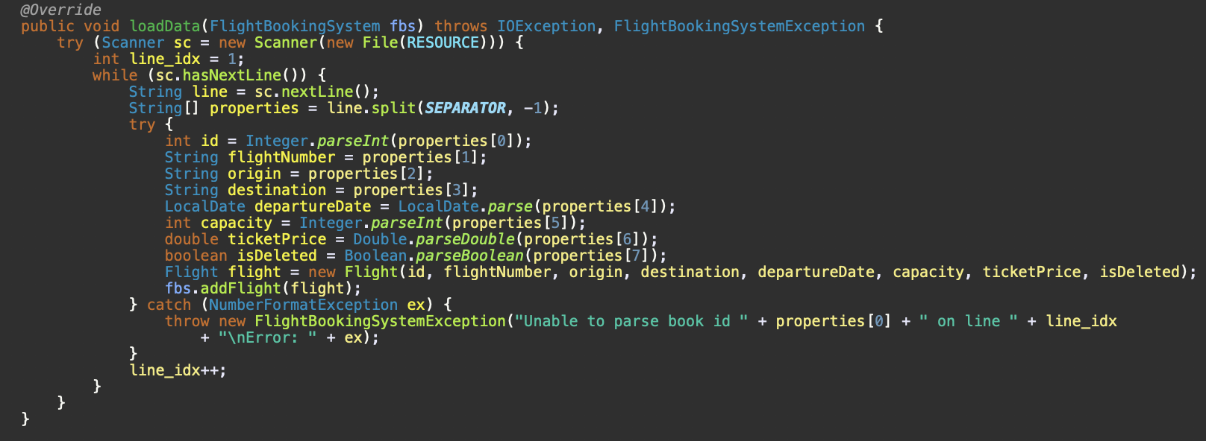
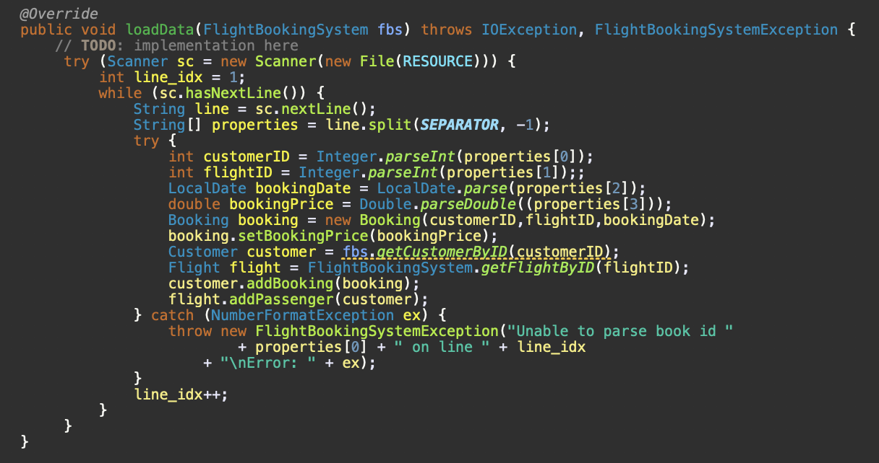
LOAD data
These Load data scripts load the various data about the customers, the flights and the bookings and read their information from their own txt file into the system

Slide 8
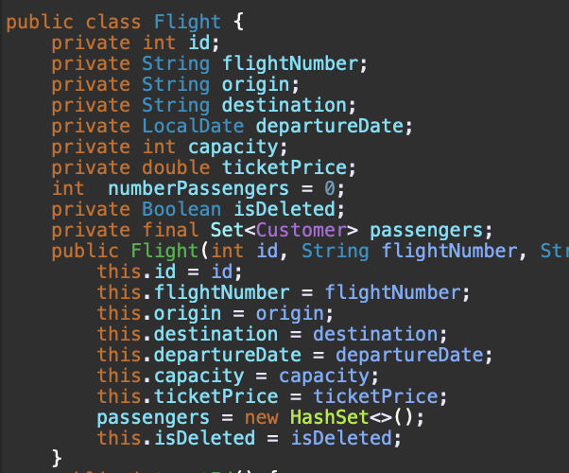
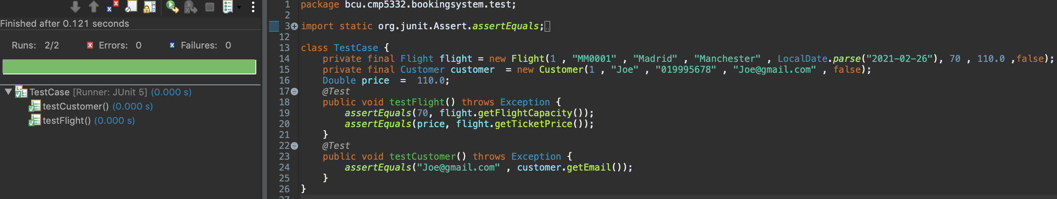
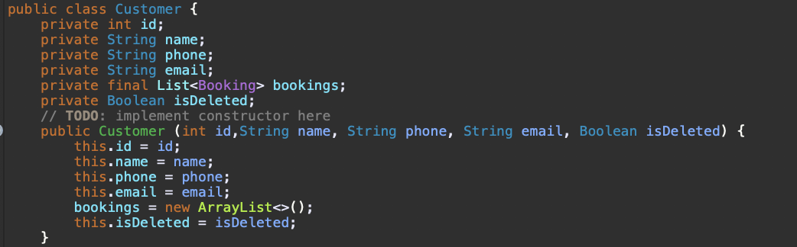
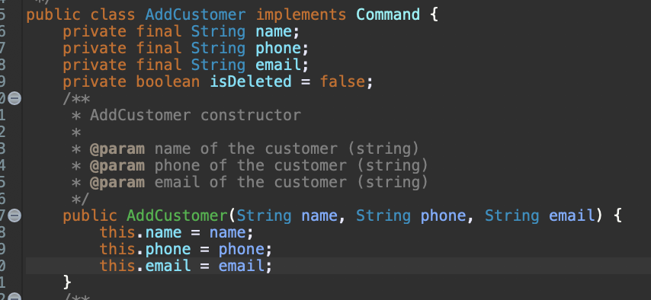
Test unit – mail - capacity
Here the mail and capacity data inserted into the customer and flight istances of the system and checked using a simple test unit

Slide 9
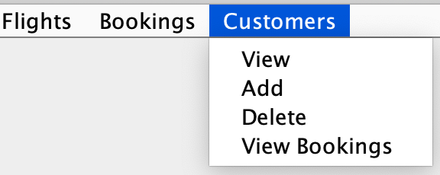
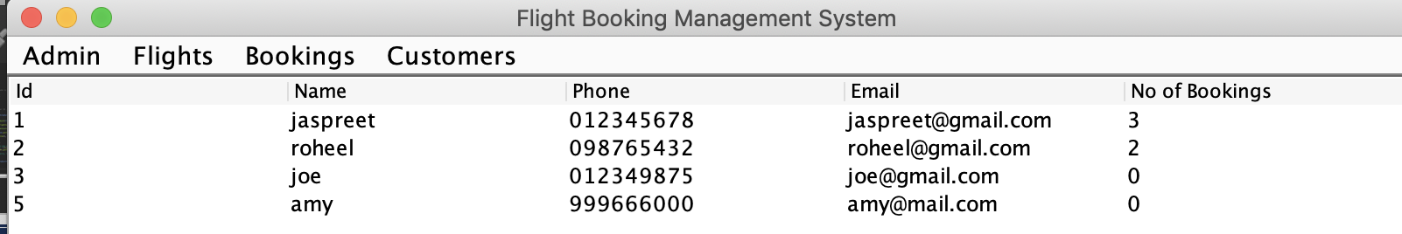
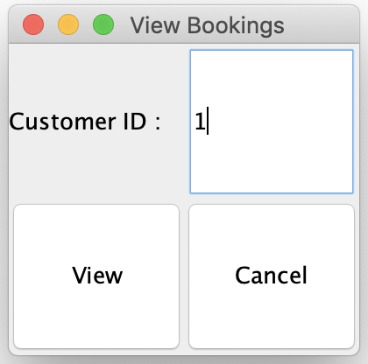
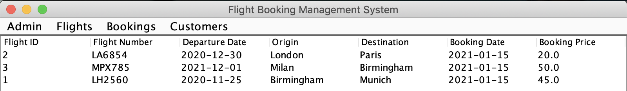
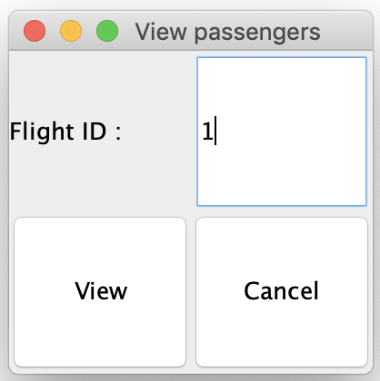
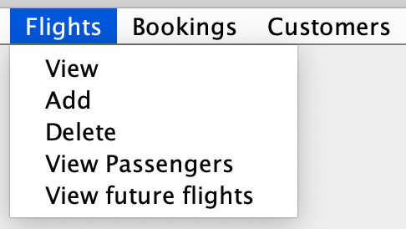
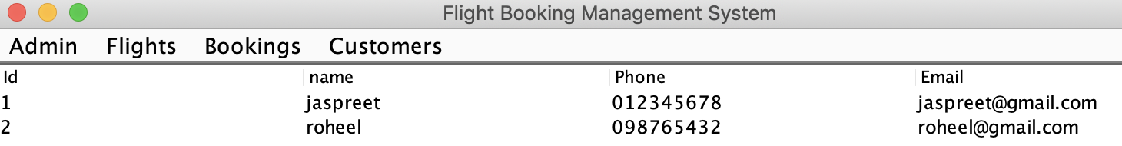
Gui - vIEW Bookings/CUSTOMERS/PASSENGERS LIST
With the various popups menu options it’s possible to view the customers list, the flight’s passengers and customer’s bookings after inserting the flight/customer ID as an input in the window apperating on screen

Slide 10
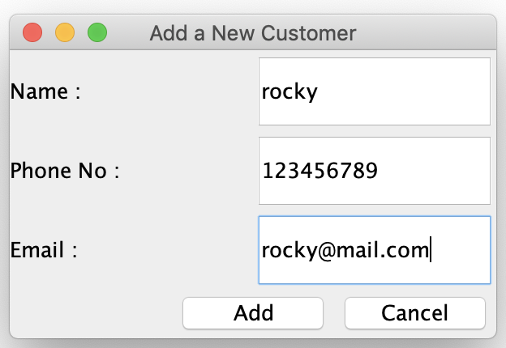
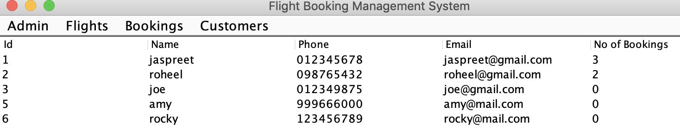
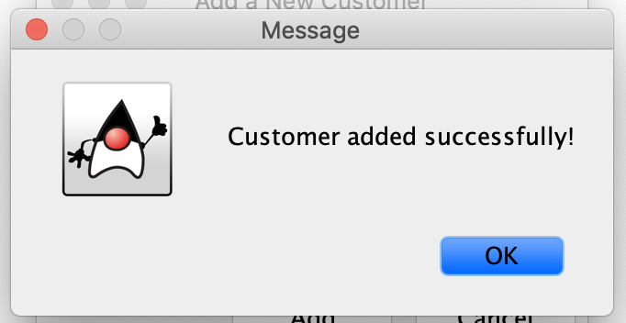
Gui - adding new cUSTOMER
Here using ther popup menu options we can insert a new customer after putting the customer’s information into the right textboxes inside the windown that will appear on screen

Slide 11
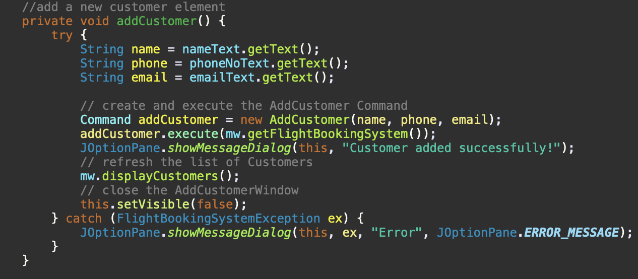
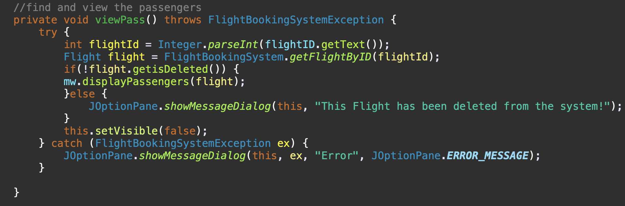
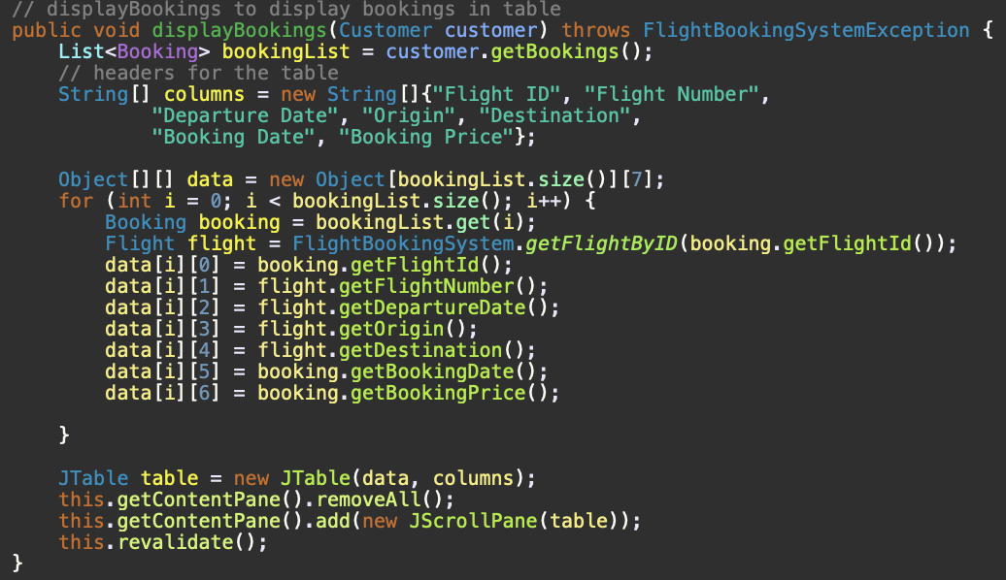
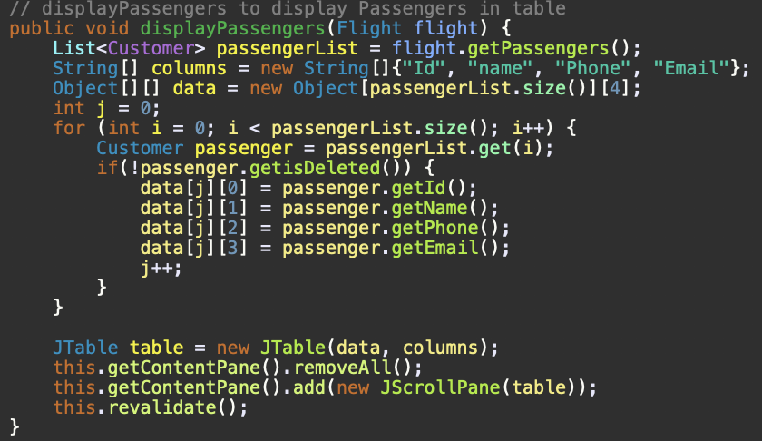
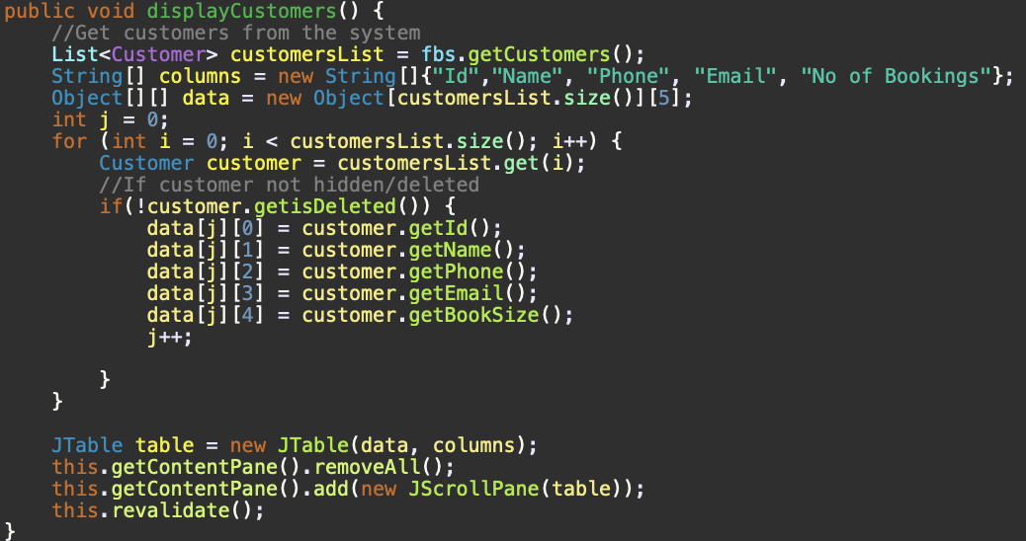
CODE OF gUI ELEMENTS

Slide 12
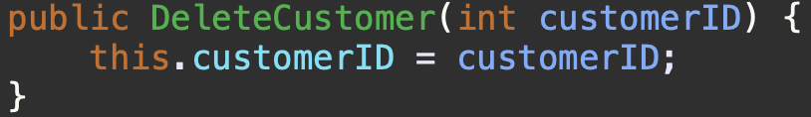
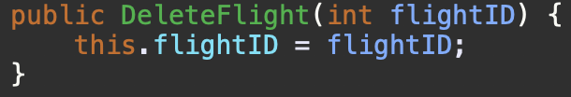
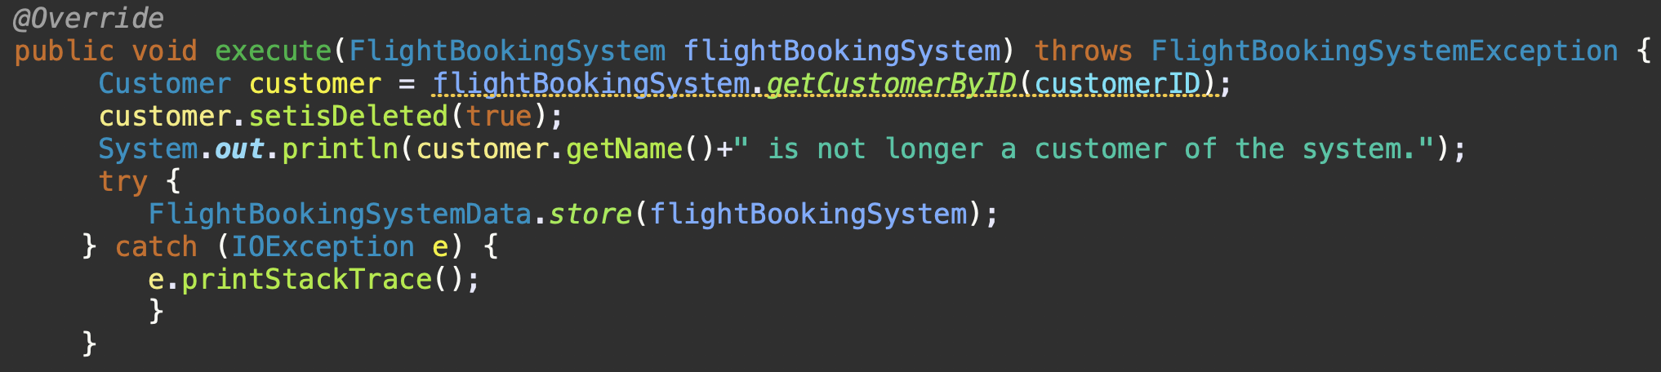
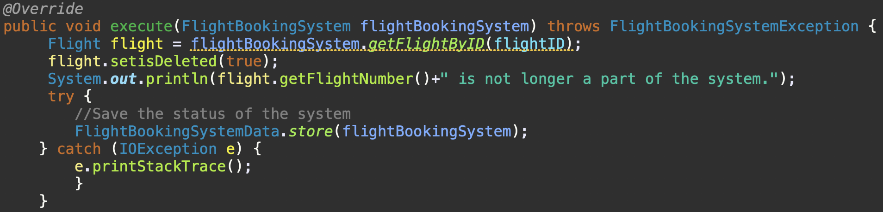
Remove ( hide ) Customer / flight
Here the code to delete or hide the customer / flight using a isDeleted boolean variable and setting it to true that will be used to indicate if the element will be listed when printing all the elements

Slide 13
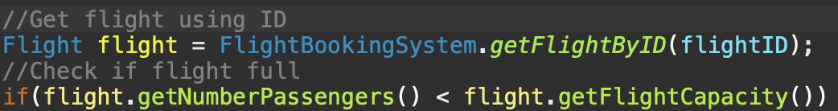
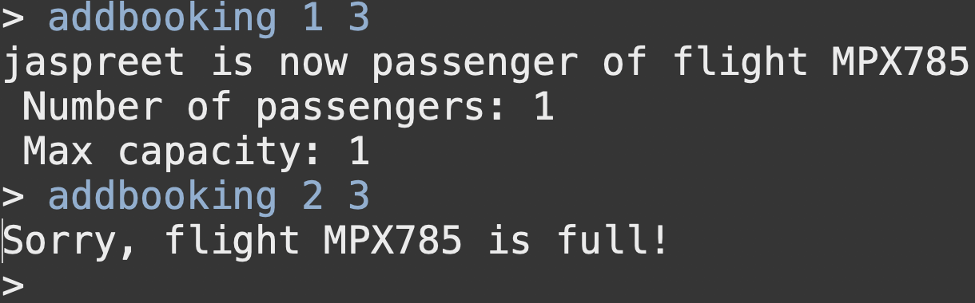
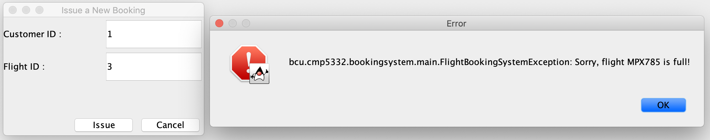
Impose limit of passengers on flights
Here the code to impose a max limit on flights as capacity of the flight and when trying to add a new passenger to the flight, the proigram blocks the user to do so

Slide 14
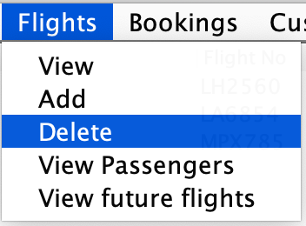
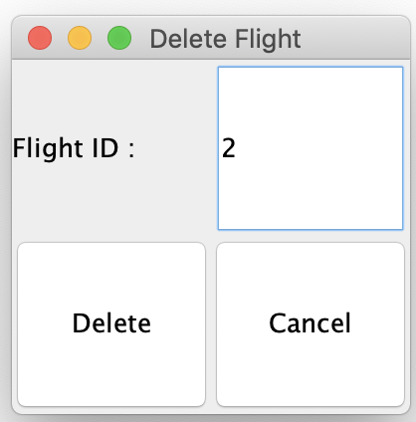
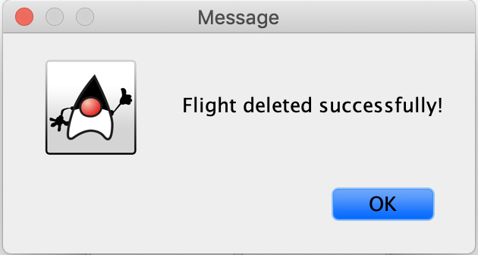
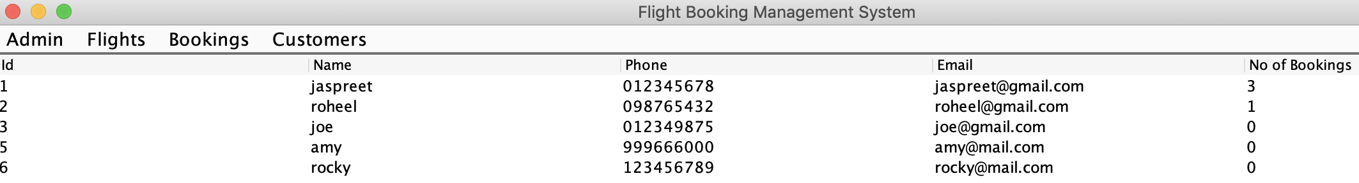
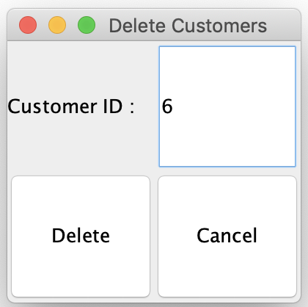
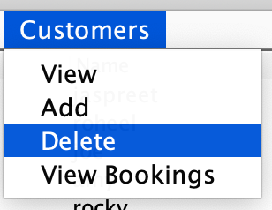
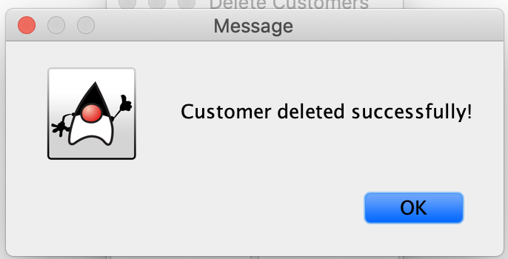

Delete customer / flight
Here the code to delelte the customer and flight implemented in the GUI too

Slide 15



JAVA DOC
Here the creation of the javadoc files with all the classes, methods, etc.

Slide 16



View only future flights
Here the code and GUI to show only the flights that are gonna fly in the future

Slide 17








ADD / CANCEL BOOKINGS USING GUI
Here the GUI implementation to add or delete a customer’s booking

Slide 18
END
Jaspreet singh & Roheel Ahmed
BIRMINGHAM CITY UNIVERSITY
CMP5332-A-S1
2020/2021

